Slide 1


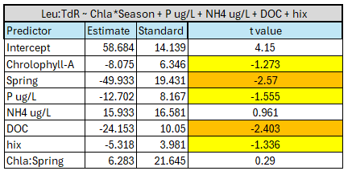
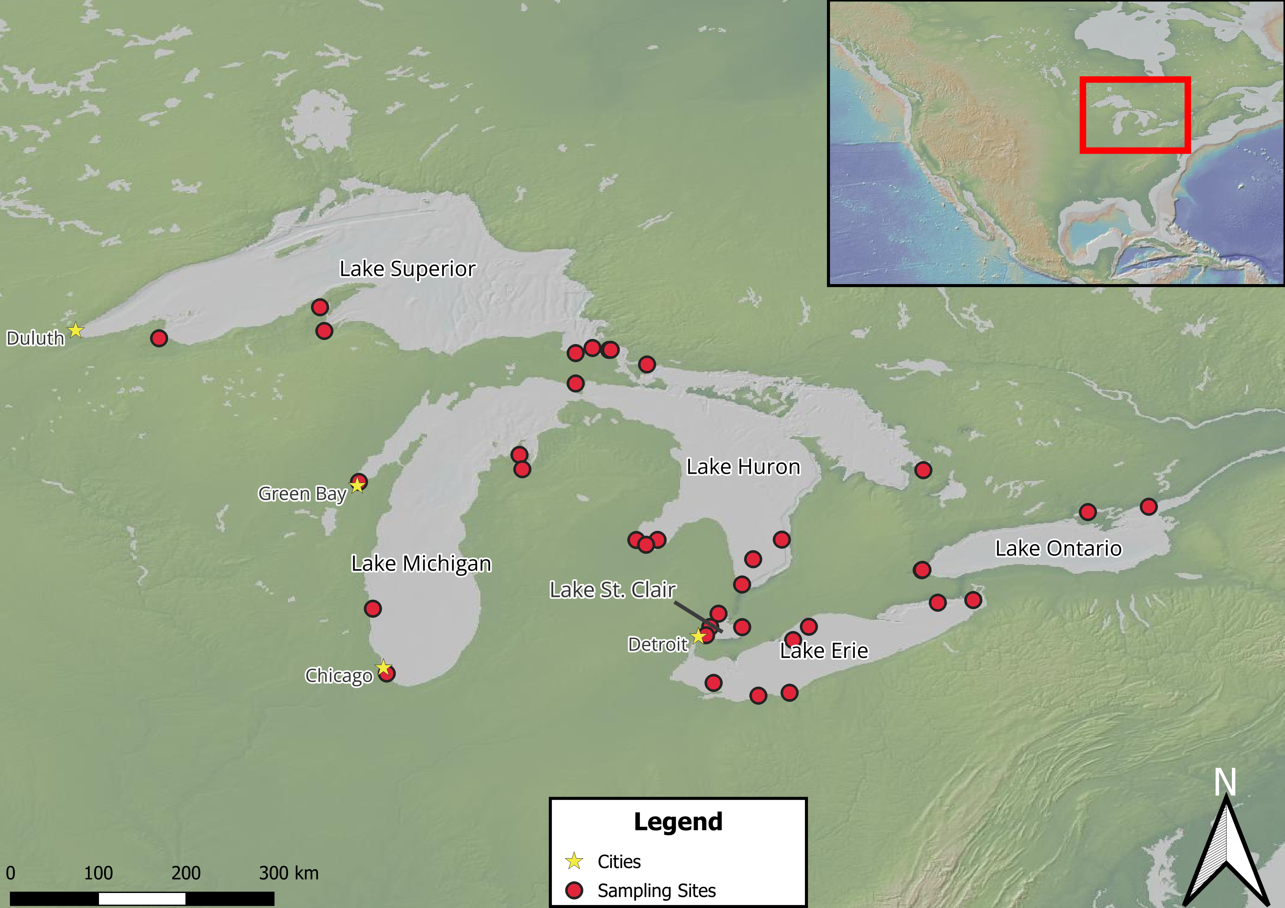
Seasonal variation in microbial community dynamics and organic matter in the Great Lakes
Connor O’Loughlin¹, Gord Paterson¹, Nicole Wagner², Hunter Carrick³, Jonathan Doubek⁴, Donald Uzarski³, Trista J. Vick-Majors¹, with the Winter Grab Network
¹Michigan Technological University, ²Oakland University, ³Central Michigan University, ⁴Lake Superior State University
Introduction
Winter has been regarded as a period of relative dormancy in limnetic systems¹, characterized by low biological activity.
Recent work has shown that microbial communities remain active during winter², and important biogeochemical processes still occur
We present work aimed at understanding the microbial ecology of the Laurentian Great Lakes during winter.
Microbial Activity
Heterotrophic Bacterial Production Response to Seasonal Chl-a
Hypotheses
Microbial activity across years, lakes, and seasons will vary, with a depressed level of activity in winter, and oligotrophic lakes exhibiting lower activity.
Activity will be modulated by primary production, dissolved organic matter (DOM), and nutrient availability.
Dissolved organic matter quality and concentration will control microbial activity.
Figure 2. The ratio of leucine uptake relative to thymidine uptake is indicative of microbial activity, with a larger value suggesting microbial maintenance as opposed to growth. The grey dotted line represents a 1:1 relationship. Lake, Year, Season are not significant explanatory variables (P value = 0.24, 0.54, 0.32 respectively)
Figure 4. This fitted response plot shows the fitted values for bacterial production response to chlorophyll concentration across seasons. The shaded region is the 95% confidence interval for each slope.
Modeling Microbial Activity Response to Seasonal Predictors
Conclusions
Season, Year, and Lake do not account for enough variation in bacterial production (Figure 2).
Carbon quality varies across lakes (Figure 3), but trophic status modulates summer carbon quality.
Chlorophyll-a, Phosphorus, and dissolved organic carbon concentrations along with relative humification and season control bacterial production (Table 1).
Higher phytoplankton abundance in summer results in decrease in bacterial production, which may be a result of shifting grazing pressures (Figure 4).
Table 1. Predictor variables were selected by screening univariate linear regression models with Leu:TdR as the response variable. Predictor variables were selected by comparing the univariate AIC scores. t values highlighted in yellow are significant at p < 0.05, with orange cells being highly significant (R² = 0.43).
Methods
Bacterial production was measured via incubations with tritiated leucine and thymidine.
Dissolved organic matter was characterized using via fluorescence excitation-emission matrix spectroscopy.
Raw water samples were used to measure dissolved inorganic nitrogen and phosphorus concentrations.
Carbon DOM Quality
Future Directions
Incorporate winter nutrient and primary production in linear regression model.
Account for seasonal physical parameters such as water temperature and light.
Acknowledgements
We would like to thank Maci Quintanilla, Garrett Lukosavich, Mitch Kehne, Allen Cureton, Mari Leland, K.M. Shafi, and An Nguyen for assistance with sample collection, the Great Lakes Research Center for providing logistical and financial support, and the Great Lakes Winter Network for support. Special thanks to the Winter Grab network for participating in sample collection. This work is supported by a Michigan Sea Grant award to TVM (SUBK00020867).
Literature Cited
1. Ozersky, T., Bramburger, A. J., Elgin, A. K., Vanderploeg, H. A., Wang, J., Austin, J. A., Carrick, H. J., Chavarie, L., Depew, D. C., Fisk, A. T., Hampton, S. E., Hinchey, E. K., North, R. L., Wells, M. G., Xenopoulos, M. A., Coleman, M. L., Duhaime, M. B., Fujisaki-Manome, A., McKay, R. M., … Zastepa, A. (2021). The Changing Face of Winter: Lessons and Questions From the Laurentian Great Lakes. Journal of Geophysical Research: Biogeosciences, 126(6), e2021JG006247. https://doi.org/10.1029/2021JG006247
2. Hébert, M.-P., Beisner, B. E., Rautio, M., & Fussmann, G. F. (2021). Warming winters in lakes: Later ice onset promotes consumer overwintering and shapes springtime planktonic food webs. Proceedings of the National Academy of Sciences, 118(48), e2114840118. https://doi.org/10.1073/pnas.2114840118
Figure 1. This map shows sites sampled from February 2024 to February 2025. A geographical reference of the Laurentian Great Lakes is shown in the upper right corner.
Figure 3. The HIX value is a spectral index used to measure the relative humification of DOM in a water sample. Higher values indicate higher relative humification and organic matter that is more refractory.

